Slide 1
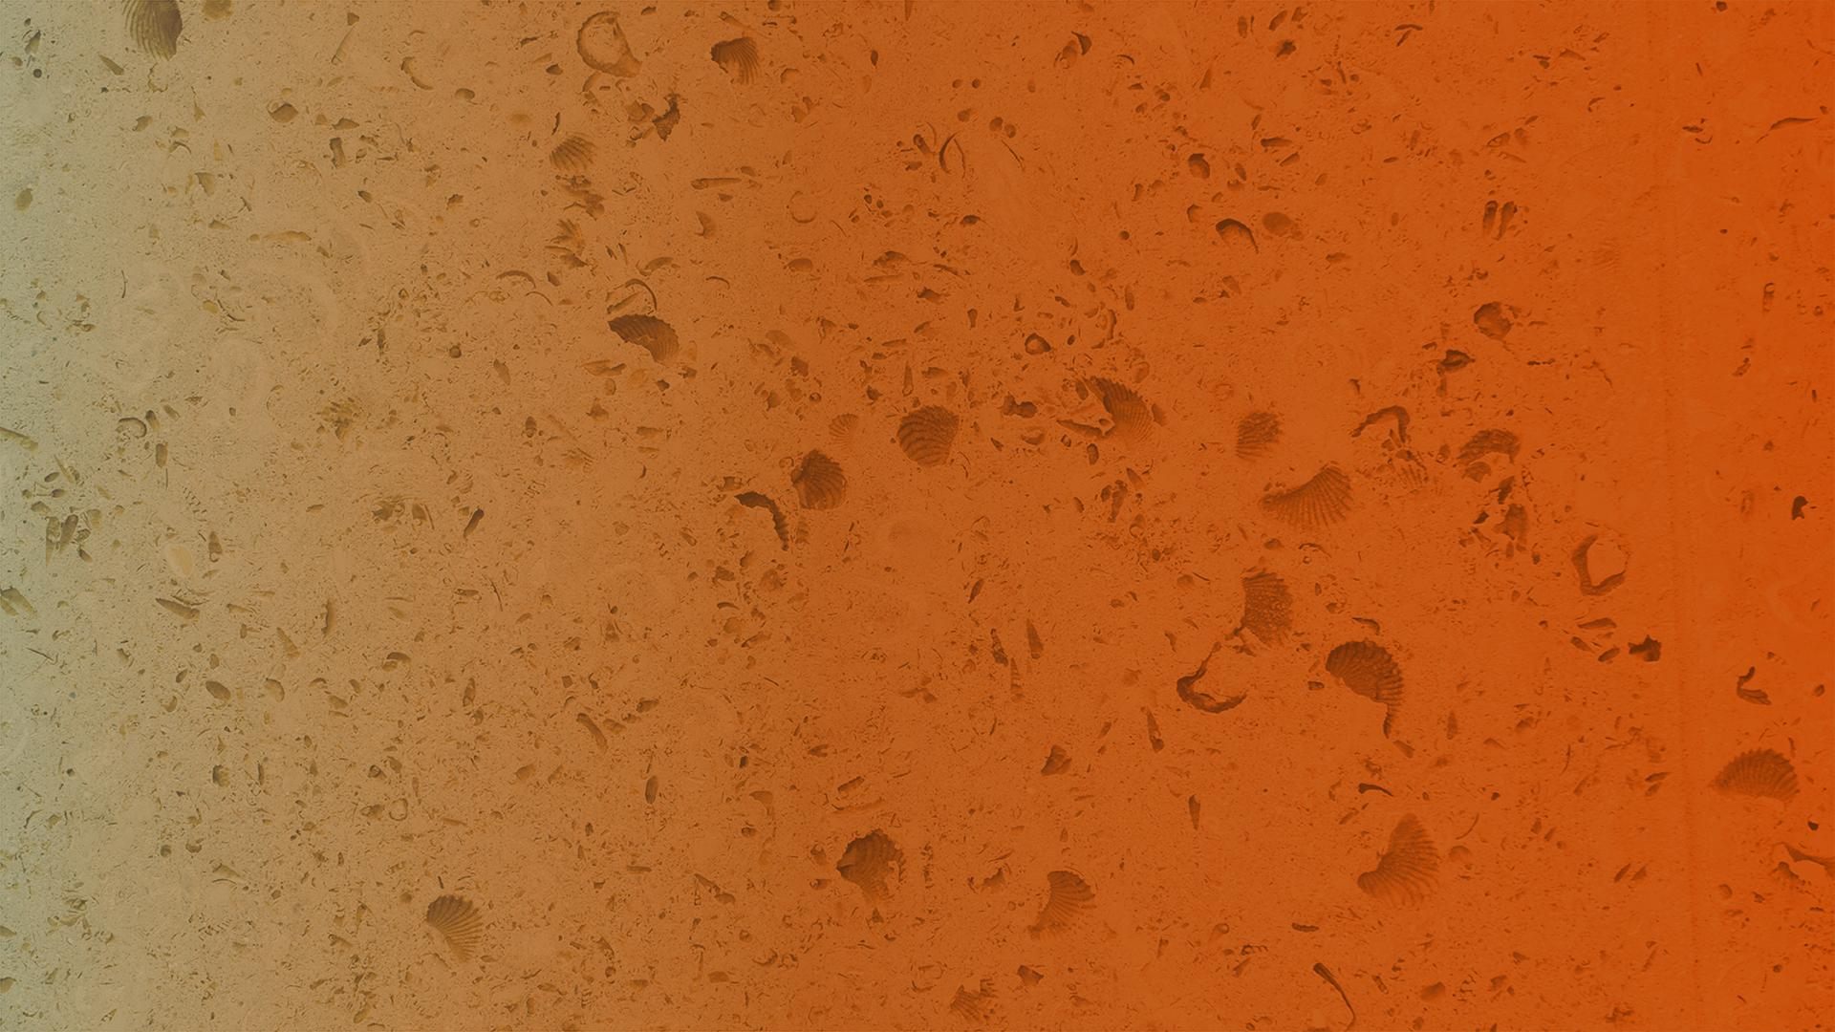

May 2021
White Noise Reduction using Style-Based Generative Adversarial Networks
Rahul Shanmugham, Denzell Ford, Alexander Billiot, Lydia Wharton, Swapnil Shaurya,

Slide 2
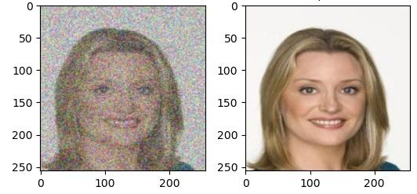
What is our problem?
White noise is random variation in any part of data that results in skewed data.
Appears as specks and variation of color in images and loud static in audio data.
Causes many problems in the field of data science, specifically data unusability.
Notes:
Rahul
In images, it appears as specks and variation of color and is very difficult to remove. In audio, it can appear as loud static. As we can see below, the image on the left is an image that contains around 50% white noise. The image to the right is the exact same image without any noise.

Slide 3
Why it matters?
Much of the data that has been acquired for research purposes cannot be used due to the random flaws found within them.
Our research would allow us to remove these flaws, thus allowing data to be used much more widely than it is now.
A simple real-world use case for our project would be removing static and white noise found in CCTV camera footage.
Notes:
Rahul
Why white noise hard to get rid of / how is it important
White noise occurs due to limitations of image processings and can cause a variety of problems such as grainy images and the inability to process data effectively. Due to its nature, white noise is hard to eliminate without additional “help” in the form of adding an underlying structure to images.

Slide 4
Our Project
Any and all sorts of data have a pattern that can be differentiated.
Our goal is to locate and use these patterns within images to filter out extraneous white noise.
To do this, we are creating a framework that utilizes a generative adversarial network (GAN) to train on images containing various noise levels.
Notes:
Rahul
Our project is based upon the fact that any and all sorts of data with or without noise has a distinguishable pattern. Our goal: find a way to locate patterns within images and audio waves and use those patterns to filter out the white noise in them.
To do this, we are creating a GAN, based on the StyleGAN, that trains on images and audio data containing various noise levels. The GAN will eventually be able to generate images that contain little to no white noise.

Slide 5
Initial Problems and Setbacks
Too broad of a research question
Initially began our project by utilizing a StyleGAN
A general StyleGAN has to “squash” an image into a single vector to begin training.
Exploding/Vanishing Gradients resulting in little/no training.
Notes:
Denzell.

Slide 6
Pixel2Style2Pixel Framework
Image to Image Translation
This model works better with image inputs and uses a pre trained StyleGAN to generate the output image
We used the StyleGAN Encoding pretrained model
We used a combination loss of mse, identity lambda loss and lpips loss.
Model only trained the encoder
Notes:
Alex

Slide 7
TACC Implementation/Issues
Compiling the C++ Extensions:
Our StyleGAN required certain pretrained C++ extensions that were not compiler compatible with the Maverick2 machine at TACC.
Used Docker to compile our model on a system (centOS 1810) similar to Maverick2.
Out of Memory Errors:
Our model was using too much memory on the GTX node causing CUDA errors.
Transitioned to v100 GPU nodes in order to have more memory to train our model.
Notes:
Denzell

Slide 8
Training Setup
Trained on the CelebA dataset and used the pSp pre-trained model for StyleGAN inversion.
Batch size of 1x256x256 using the Adam optimizer with a learning rate of 0.0001.
Trained for ~40,000 iterations through our dataset.
Notes:
Denzell

Slide 9
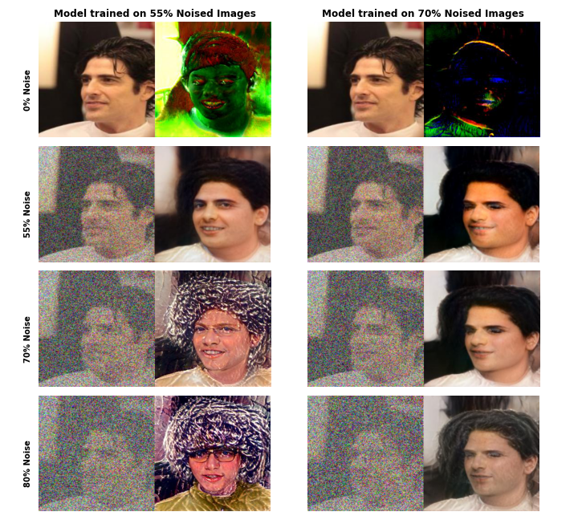
Final Results
Notes:
Alex

Slide 10
Quantitative Results
Noise Level Trained On | Noise Level Evaluated On | FID Score ( sample size 500)
0.55 | 0.55 | 77.65
0.55 | 0.70 | 193.93
0.70 | 0.55 | 81.25
0.70 | 0.70 | 82.18
0.70 | 0.80 | 122.71
Notes:
Lydia
here are some quantitative results. Left column, noise levels. mid column: noise levels tested on. right column: FID score, which is a way of evaluating how well our generated images are against the original noised images. lower the score is, the better the generated images.
as Alex mentioned, the model does best when the noise level trained and evaluated on is same or when the noise level evaluated on is at a reasonably lower level than the noise level trained on. and the model didn’t do very well when the noise level tested on is higher than the level trained on (as you can see by the high FID score)
From these results we think that our model could get good results at an even higher noise level such at 80 or 90%, as Alex will talk about next

Slide 11
Generalization to Greater Noise Levels
Noise Level Trained On | Noise Level Evaluated On | FID Score ( sample size 500)
0.55 | 0.55 | 77.65
0.55 | 0.70 | 193.93
0.70 | 0.55 | 81.25
0.70 | 0.70 | 82.18
0.70 | 0.80 | 122.71

Slide 12
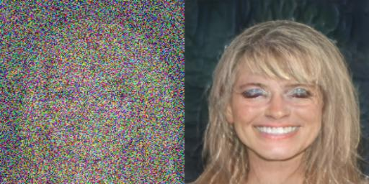
Limitations
Model overfits to a single noise level
“Spiking” loss due to differences in white noise reduction (larger batch size might help)
Loss of small details in high noise (such as eyes becoming “purple”)
80% Noise on 70% model
Notes:
Lydia
some of the limitation of our model

Slide 13
Future Work
Dynamic noise level during training
Allows the model to generalize better
Resolving loss of information at higher noise levels
Use multiple potential outputs
Dataset
Standardize format, diversify features
Other applications of image-to-image translation principles
Notes:
Swapnil
To address some of the limitations Lydia pointed out, we have some ideas for future work.
Firstly, to correct the overfit of the model to specific noise levels thay Alex and Lydia mentioned, we would try using inputs with varying noise levels to try and make the model generalize better. In real-world applications, it would be difficult to get matching levels of noise on the inputs and training data, so by training it on a wide range of noise levels the model should be better equipped to handle the diverse levels of noise found in the real world.
Additionally,to address the loss of information at high noise levels, we looked into using multiple potential outputs from the model because there is so little data initially in the input to go off of.
Also, our dataset could be updated to further improve results. We would standardize the format of the inputs and ensure the images are all frontalized, basically making sure the subjects look directly at the camera. We can also address bias within our dataset by trying to diversify the features present within it. Because the images come from a dataset of celebrity faces, certain features may be overrepresented and thus our model gets thrown off by any deviations from this norm.
And we want to encourage looking into other applications of the image-to-image translation principles, which I’ll talk more about on the next slide.

Slide 14
Conclusion
Demonstrated efficacy of using StyleGANs with pSp to reduce white noise at high noise levels
Tradeoff between accuracy and noise reduction
Broad applicability of style matching technique and image-to-image translation
Notes:
Swapnil
In conclusion, our work has successfully demonstrated the efficacy of using style GANs with the pixel2style2pixel framework to achieve white noise reduction at high noise levels (potentially 80-90% as pointed out by Lydia). This is accomplished by trying to emulate the target instead of trying to match the target exactly.
One consequence of this is that we make a tradeoff between accuracy and high levels of noise reduction. Thus, our model may not be as useable in situations where the accuracy of the output is extremely important. It still does, however, have many uses where mass amounts of noise make it difficult to restore an image.
And perhaps the most important point from this project is that while our specific implementation of the style-matching technique is limited in its scope to just removing white noise from faces, it could be applied in a multitude of ways because of the universal pattern of white noise. Some examples could be reducing static on CCTV footage or removing distortion from images and video. We encourage looking into the different applications. And that concludes our project presentation.

Slide 15
Questions?

